Slide 1



Tech Emporium
Welcome to Tech Emporium, your one-stop shop for cutting-edge technology. We pride ourselves on providing a wide selection of high-quality computers, laptops, tablets, and smartphones to meet your individual needs and preferences. From powerful gaming rigs to sleek and portable ultrabooks, we have something for everyone.
by Ahnaf Shahriar

Slide 2
About Tech Emporium
Tech Emporium is a company built on passion for technology and a dedication to customer satisfaction. We believe that technology should be accessible to everyone, and we strive to provide a seamless and enjoyable shopping experience. Our team of knowledgeable and friendly experts is always available to answer your questions and guide you through the complexities of the tech world.
Commitment to Quality
Personalized Service
We curate a selection of leading brands and products, ensuring you receive the highest quality and reliability.
Our experts are available to help you find the perfect device to fit your needs and budget.
Competitive Prices
Convenient Options
We offer competitive pricing and frequent promotions to make tech accessible to everyone.
Shop online or visit our store for a personalized experience.

Slide 3
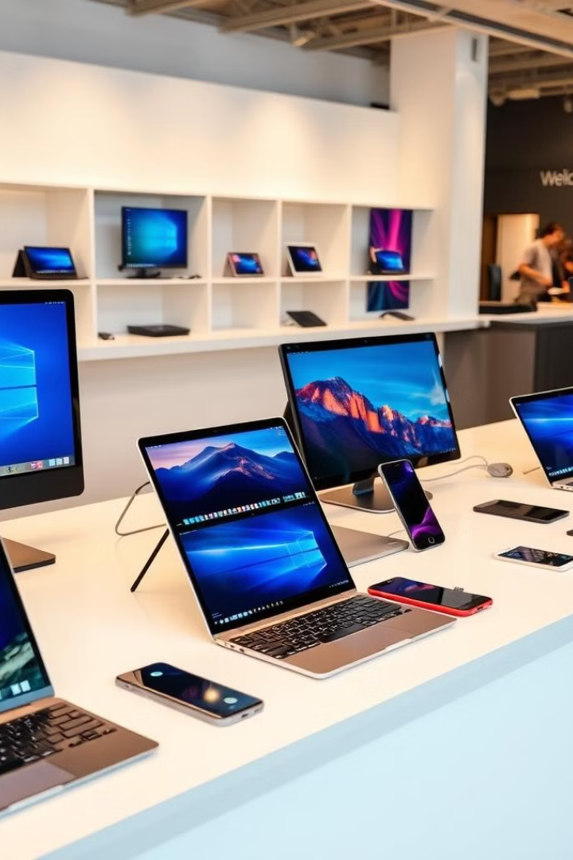
Our Product
Tech Emporium offers a diverse range of products that cater to various needs and budgets. We carry the latest models from top brands, ensuring you have access to cutting-edge technology. Our product selection includes:
1
Computers
2
Laptops
From gaming PCs to workstations, we offer a variety of desktops tailored to your specific requirements.
Whether you need a powerful laptop for work or a sleek ultrabook for travel, we have the perfect option for you.
3
Tablets
4
Smartphones
Enjoy the versatility of tablets for entertainment, work, and productivity. We carry a wide selection of sizes and features to meet your needs.
Stay connected with the latest smartphones, featuring advanced cameras, powerful processors, and cutting-edge features.

Slide 4
Services
At Tech Emporium, we are committed to providing not only great products but also exceptional services. Our team of skilled technicians is dedicated to ensuring your tech devices are in optimal working order. Our services include:
Tech Support
Repair Services
Data Recovery
Our expert team provides knowledgeable tech support over the phone, email, and in-store, assisting you with troubleshooting and product guidance.
We offer repair services for various tech devices, from basic repairs to complex hardware replacements.
Our team can help recover lost data from damaged devices, ensuring your precious memories and files are safe.

Slide 5
3 Month Sales Analysis
Over the past three months, Tech Emporium has experienced a significant increase in sales across all product categories. This positive trend is attributed to several factors, including:
1
Effective Marketing Campaigns
Our targeted marketing campaigns have effectively reached our target audience, increasing brand awareness and driving sales.
2
Improved Customer Service
Our dedication to providing exceptional customer service has resulted in increased customer satisfaction and repeat business.
3
New Product Launches
The introduction of new and innovative products has generated significant interest and boosted sales.

Slide 6

Conclusion
Tech Emporium is committed to providing cutting-edge technology and exceptional customer service. Our commitment to innovation, quality, and affordability has propelled us to become a trusted name in the tech industry. We look forward to continuing our journey of growth and success, serving our customers and providing the best possible technology solutions.

